Slide 1
BIG CITY Presentation
Group – 29
By
Umut Efe AL
Oğuz Efe GÜNEŞ
Nurettin YILDIZ
Aleyna DOĞRUER

Slide 2
CONTENTS
Introduction
Core Concepts
Functionality
Why You Should Use Our Simulation ?
Summary

Slide 3
INTRODUCTION
The focus of this project on developing an application that simulates a public transportation system within a city. The simulation will model bus lines, buses, and passengers, and generate statistics about the system. The city itself is a 21x57 grid composed of building blocks, roads, and bus stops. The core functionality involves buses moving along predefined lines, with passengers getting on and off at various bus stops

Slide 4
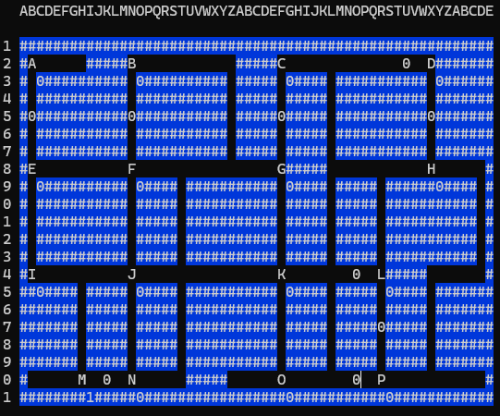
Core concepts
The simulation includes 16 bus stops, labeled A through P, with the number of waiting passengers displayed at each stop.
There are six distinct bus lines, named after their starting bus stop (Line A, Line B, Line C, Line D, Line L, Line M)

Slide 5
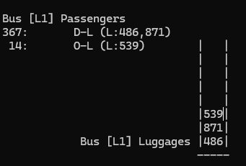
Core concepts-luggage's
The project implements a luggage system where each passenger can have between 0 and 2 pieces of luggage, determined randomly.
Each piece of luggage is assigned a unique integer ID within the simulation. Buses are equipped with a dedicated luggage department capable of holding up to 8 pieces of luggage.
A key aspect of the luggage system is that placing or retrieving luggage on a bus takes a specific amount of time: 1 unit-time per operation.

Slide 6


Core concepts-luggage's
The project's luggage system simulates a stack-like behavior within each bus, meaning only the topmost luggage can be operated on.
This is managed by two primary functions: loadLuggages and UnloadLuggages.
The loadLuggages function handles the process of adding luggage to the bus's internal stack. Conversely, the UnloadLuggages function is responsible for removing luggage from the bus.

Slide 7
Core concepts-passenger’s
Passengers in the "Big City" simulation are dynamically generated, each assigned a unique integer ID. These passengers are created randomly, including their desired bus line, their starting and ending bus stops, and the random time at which they enter the simulation.
Upon generation, passengers are initially placed into a queue. This queue consistently maintains 15 elements and is always full. Within this queue, passengers are represented by their initial bus stops. To simulate a staggered entry, each passenger in the queue waits for a random duration of either 0 or 1
Once a passenger "enters the simulation," they proceed to their designated initial bus stop to await a bus.

Slide 8
Core concepts-busses
Our simulation features intelligent buses capable of autonomous movement and passenger management.
Each bus independently calculates its current position and determines its next destination along its assigned bus line.
When a bus arrives at a designated bus stop, it can efficiently manage passenger boarding and alighting. This includes allowing passengers to get on, provided there's sufficient space for them and their luggage.
This self-sufficient movement and integrated passenger/luggage handling allow the buses to effectively simulate a dynamic public transportation system within the "Big City“.

Slide 9
Functionality-choosing the bus
Our "Big City" simulation provides an intuitive way for users to inspect the details of any bus within the system.
By simply clicking on a bus displayed on the city map, users can view comprehensive information about that specific vehicle.

Slide 10
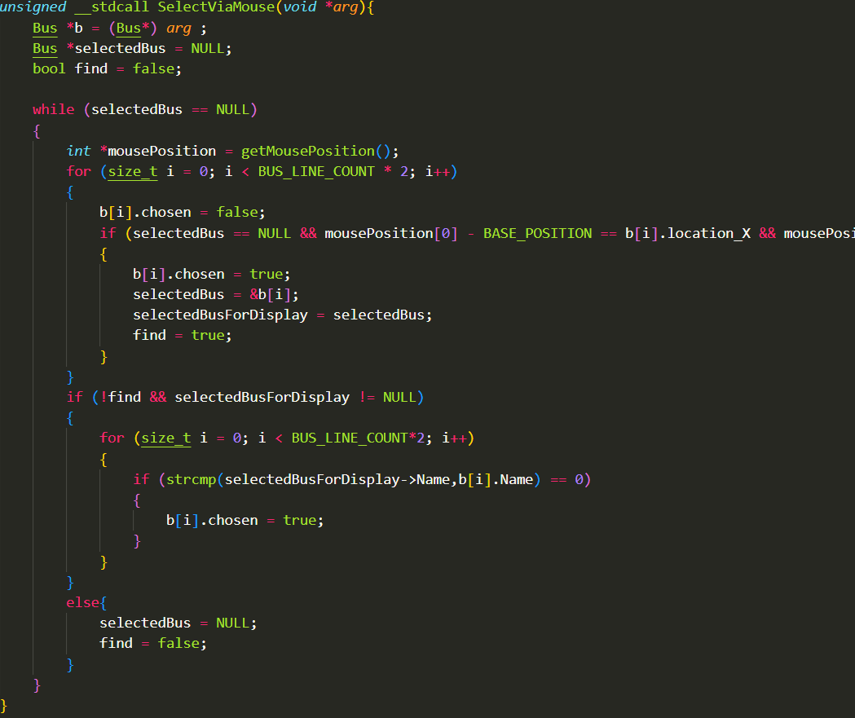
Functionality-choosing the bus
The interactive display of bus information is made possible through careful handling of mouse events. Utilizing the windows.h library, the simulation continuously monitors for mouse clicks within its graphical window.
Upon detection of a click, the precise screen coordinates (X, Y) of the mouse cursor are captured. These coordinates are then cross-referenced with the known on-screen positions of all active buses. When the recorded mouse click position aligns with the visual area occupied by a bus, the system registers this as a user's selection of that specific bus, triggering the display of its detailed information.

Slide 11
Functionality-Stop&Start
The "Big City" simulation offers flexible control over its execution through simple keyboard commands, allowing users to start, pause, and advance the simulation as needed.
Users can start the simulation by pressing the 'R' key, initiating bus movement and passenger activity. Conversely, the simulation can be paused at any time by pressing the Space key, providing an opportunity to observe the system's state.

Slide 12
Why You Should Use Our Simulation ?
You should use our simulation to:
Understand Public Transport: See how buses, passengers, and lines interact in a city.
Analyze System Performance: Generate statistics to evaluate and improve the transport system.
Learn Interactively: Control the simulation and inspect details of buses and stops in real-time.

Slide 13
SUMMARY
This project successfully implemented a bus simulation for a 21x57 city, fulfilling core requirements for bus lines, stops, and passenger interactions. We've established fundamental operations, demonstrating buses moving and managing passengers and luggage effectively. Future enhancements could include realistic traffic, dynamic passenger emotions, and a driver performance system to boost realism and engagement. Overall, this effort offered significant experience in system design and user experience enhancement

Slide 14
THANK YOU
Group – 29
By
Umut Efe AL
Oğuz Efe GÜNEŞ
Nurettin YILDIZ
Aleyna DOĞRUER

